Slide 1

Welcome!
Code for Climate
Please sit in alphabetical order based on the letter you have received

Slide 2
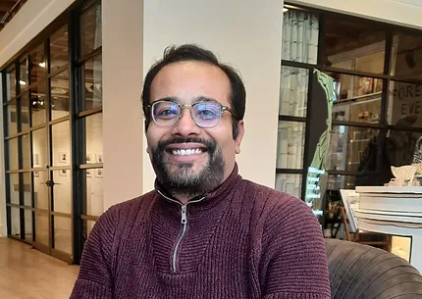
Introductions: Dr. Somesh Roy
Historian of soot

Slide 3

Introductions: Khaled Mosharraf Mukut Ph.D Student Computational Combustion Lab (CCL) Marquette University
From Bangladesh
Curious to learn new things
Love travel and photography
Gets bored quick doing repetitive things

Slide 4
Now it’s your turn!
Tell us how you want us to call you
Tell us something – other than which school or grade you are in – about yourself. Maybe …
some interesting facts
what you did this summer
what’s your favorite food
something else, altogether!
Tell us of two things that start with the letter you received.
And, if you can and you’re comfortable, tell us why these two words popped up in your head?
Ask me something – anything!

Slide 5

Logistics
How well do you know your computer?
Can you find out the following for the laptop you are using?
OS version
RAM
Processor type and speed
Will you have access to a computer / laptop at home?
Will you be able to do some homework each day?
Will you be able to install some stuff at the laptop/computer at home?

Slide 6

Logistics
Have you heard of something called “git”?
It is a version control system, i.e., it automatically keeps track of changes being made.
It is very useful for programmers and for folks who collaborate with others

Slide 7
Logistics
Do you have a github.com account?
If not, let’s create one
We will navigate this program as a github team
About our online life
Don’t talk to strangers
Look both ways
If the offer seems too good to be true, it probably is
Do not reuse passwords
Use passphrases instead of passwords

Slide 8
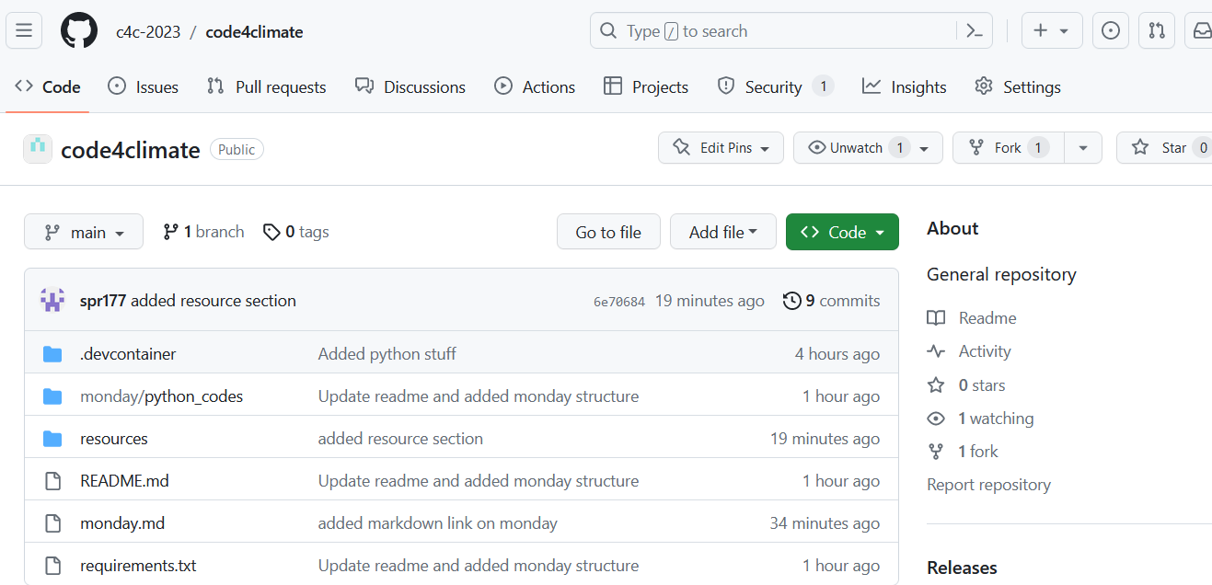
Our home: c4c-2023@github.com
https://github.com/c4c-2023
repo: short form of repository. It is the container that stores everything in git.
We will work off the repository (repo) code4climate

Slide 9
Let’s get started by creating a “fork”
A fork is your personal copy of the repository
We will use very basic functionality of git here
Sync and Fetch/Pull: Occasionally to pull new materials from the main repo
Stage-Commit-Push: To save your own work in your own fork
Notes:
They will fork C4C repo
Show them how to take notes in md

Slide 10
Code for Climate
How can we help fight climate change via coding

Slide 11
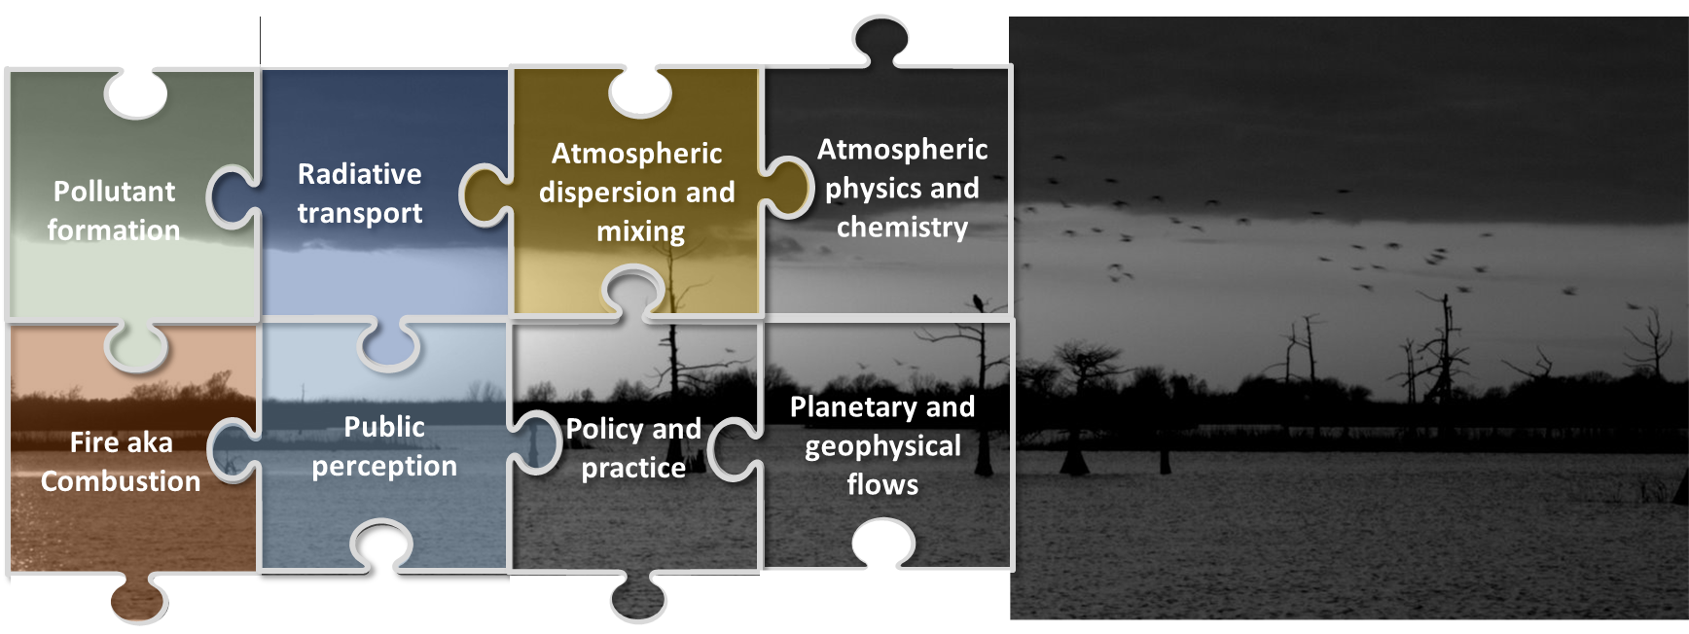
Climate is a big puzzle
It’s complex and multifaceted.

Slide 12
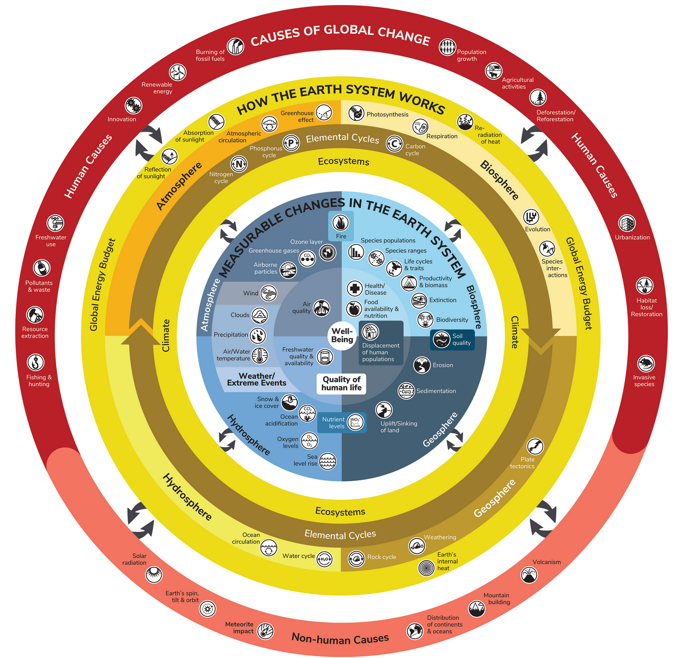
It affects our lives in many perceptible and imperceptible ways.
Some things such as health effects can be immediate
Other things such as loss of biodiversity is a slow process
https://ugc.berkeley.edu/what-is-global-change/infographic/

Slide 13


Air Quality Index (AQI)
6 Dec 1952, London at 2 pm
Definition
Units of Measure
Reporting
The AQI is an index used to indicate how polluted the air is in a certain location. It takes into account several air pollutants deemed harmful to human health.
AQI values range from 0 to 500. A low number means the air quality is good while a high number indicates serious health risks.
AQI is reported in real-time on environmental agencies' websites and apps, and it's usually color-coded to indicate how hazardous it is.

Slide 14
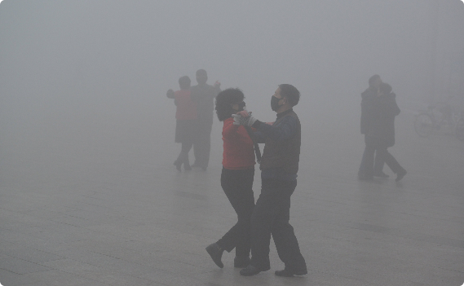

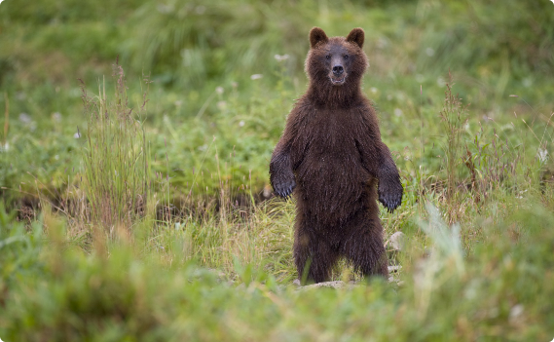
The Importance of AQI
Health
Economic
Environment
AQI is crucial to safeguarding public health as high AQI indicate polluted air and can cause respiratory diseases and other chronic illnesses.
AQI has an immense effect on economies, as polluted cities receive fewer tourists and have higher healthcare costs.
Although AQI is a metric based on public health, it’s connection to pollutants mean high AQI will harm the ecosystem and the climate.

Slide 15
The Common Air Pollutants
1
2
3
4
Carbon Monoxide
Particulate Matter
Nitrogen Dioxide
Ozone
A poisonous gas produced by cars and other vehicles that can cause headaches and dizziness when inhaled.
A mixture of tiny particles that can be inhaled, including dust, dirt, soot, and smoke that comes from fires.
A gas from burning fossil fuels that can harm the respiratory system and weaken the immune system.
A gas that can be harmful to people with respiratory problems in high concentrations. It's formed by a reaction between sunlight and certain pollutants.

Slide 16
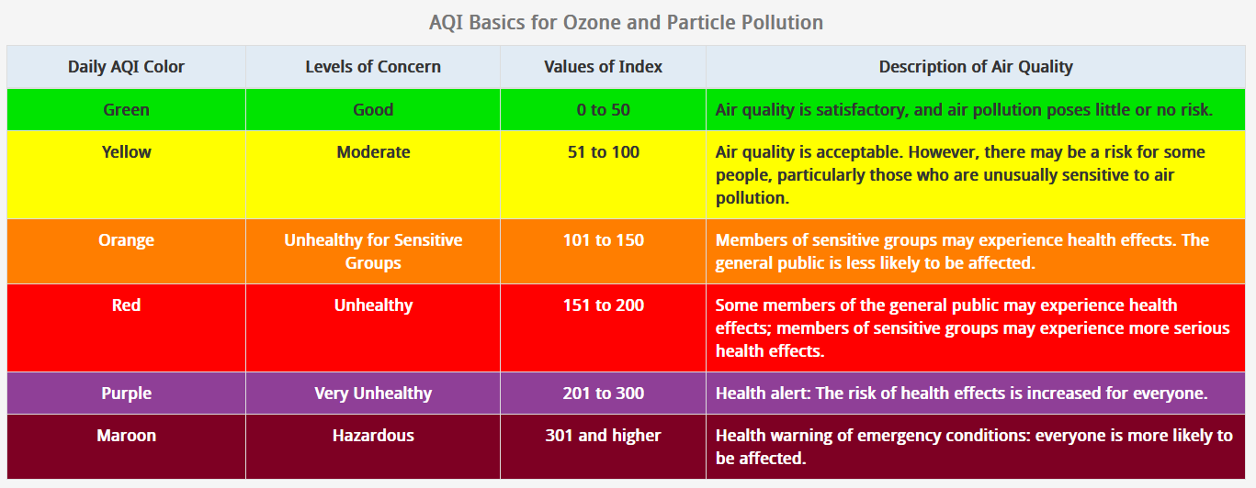

Slide 17
Responsibilities
Stay Informed
Take Action
Spread the Word
Be aware of AQI updates in your area and how they might impact your health and daily routine.
Take steps to reduce your personal contribution to air pollution, such as recycling, using public transport, and running your home energy efficiently.
Help raise awareness about AQI and its impact on human health and the environment.

Slide 18
At the end of this week
We will know something about air quality index and learn to visualize some real air quality data

Slide 19

Let’s take a break
Let’s reconvene in 10 minutes

Slide 20
Let’s shuffle: The anagram game
Look at the letter you have received. See what letters did others receive. Now, work as a group and re-seat yourself in a way that the letters are arranged in two words.
Hint: I am already sitting at an appropriate position with a letter already!

Slide 21

What is Coding?
Do you think there was any coding involved in the anagram game we played?

Slide 22

How computer programs work

Slide 23
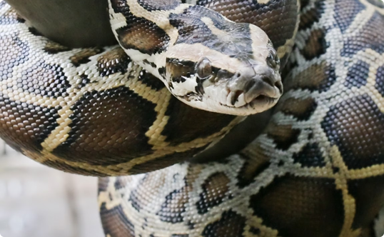
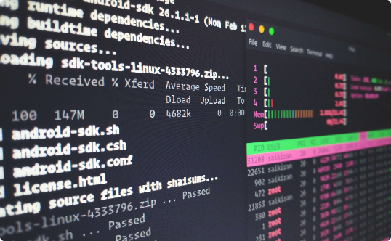
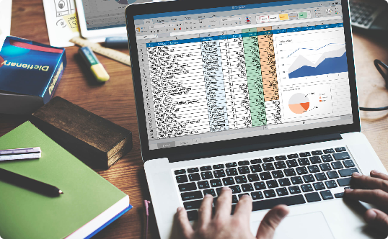
What is Python?
It’s not a snake 🐍
It's easy to learn 💻
It's versatile 🤹‍♀️
Python is a coding language used to create software, games, and websites.
Python has a simple vocabulary and is not bogged down with complex syntax. It’s easy for beginners to understand and use.
Python can be used for web development, game programming, data analysis and more.

Slide 24
Why Python is a Great Language for Beginners
Readability 📖
Simple Syntax 🤩
Community 😊
Python is easy to read and understand, making it accessible to beginners.
Python’s syntax is clean and straightforward, with fewer rules than other languages.
The Python community is supportive and welcoming to new learners. There are forums, blogs, and free resources available.

Slide 25
Installing Python on different operating systems
Go to the official Python website (https://www.python.org/downloads) and download the appropriate version for your operating system.
Follow the installation instructions to complete the process.
Once you have installed Python, you can open a command prompt or terminal window to start coding in Python.

Slide 26
How to Install Anaconda for Python
Anaconda is a popular distribution of Python that comes with many pre-installed packages and tools that are useful for scientific computing and data analysis. To install Anaconda, follow these steps:
Go to the Anaconda download page (https://www.anaconda.com/products/distribution) and download the appropriate version for your operating system.
Follow the installation instructions to complete the process.
Once you have installed Anaconda, you can open the Anaconda Navigator application to access the Spyder IDE (Integrated Development Environment) or jupyter notebook for coding in Python.
Using Anaconda can make it easier to get started with Python and ensure that you have all the necessary tools and packages installed.

Slide 27
Running locally or remotely
What is github codespace?

Slide 28
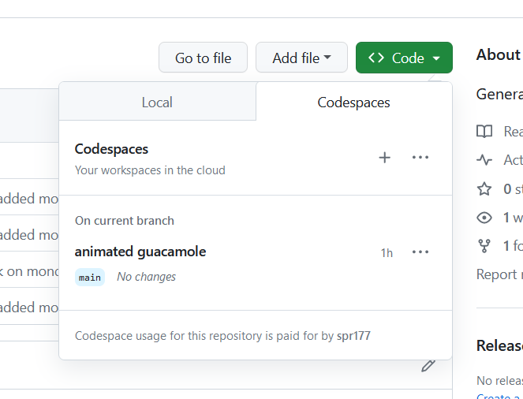
Codespace gives you a remote working environment from anywhere
Try launching your forked repo in a new codespace
Let’s have a look-around in the codespace created
It’s a Linux machine!
Try some simple Linux commands
$ ls
$ ls -l
$ cd
$cat /etc/os-release

Slide 29
Hello, World!
Go to your fork and “sync” with main branch
Go back to your codespace and “sync” again
Now you should have the new notebook (ipynb file) created
Now modify the code to add your name, like
Hello, World!
This is <your-name>
What is a kernel ?
There are three ways to run a Python code. Try them all
We recommend that you use the notebook

Slide 30

Save your work
Save your work and commit it to git
Finally push this to your forked repo
Note: You will have to add a comment to indicate why you pushed this commit

Slide 31

Let’s play a game
We need some words!

Slide 32

Now is your chance to create your mad libs game
Follow the instruction given on the paper.

Slide 33
Save your work
Save your work and commit it to git
Finally push this to your forked repo
Note: You will have to add a comment to indicate why you pushed this commit

Slide 34
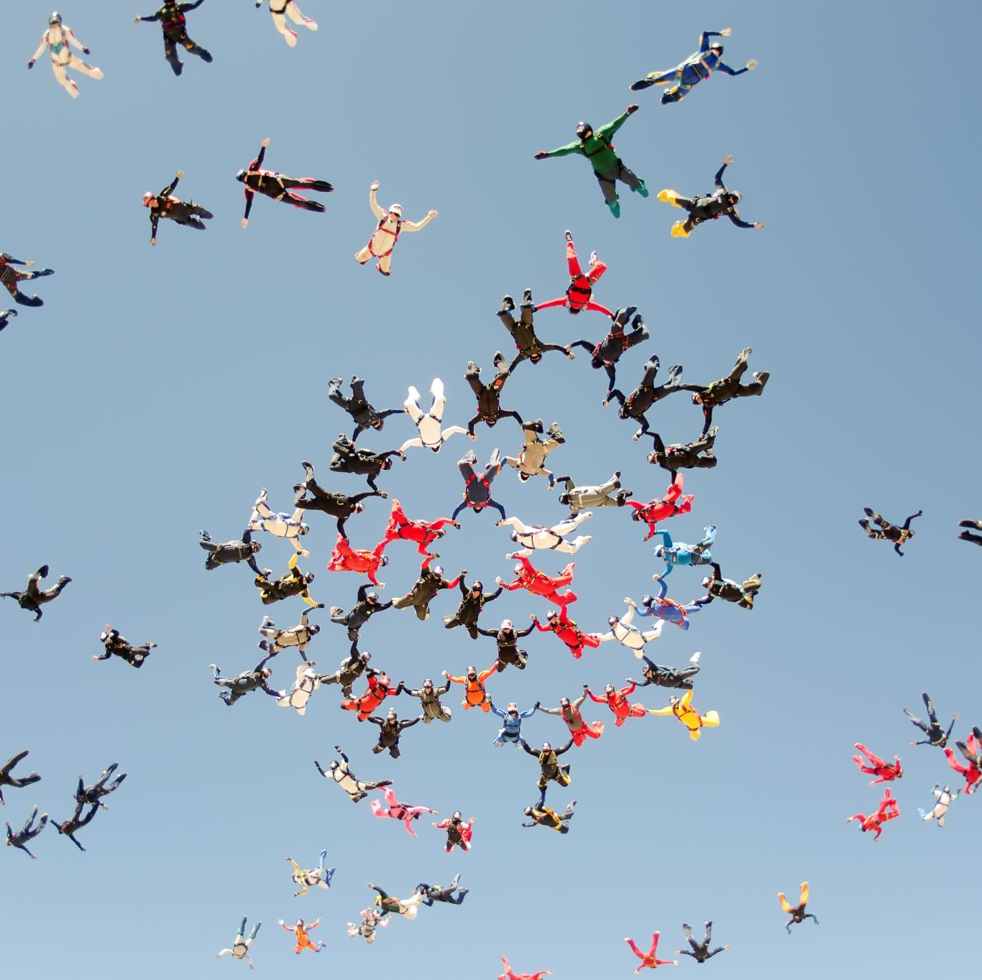
Closure
What has been the most confusing and complex?
Post it in the Muddy Points forum
We learned a bit about git and github
We accessed and navigated through a git repository
We learned a bit about air quality index
We wrote a couple of Python programs
And, we made some new friends!

Slide 35

Coming up…
Will you be able to install Python in your laptop at home?
Share your experience with installation or attempt to write some new Python code in the forum
Tomorrow we will delve into the structure of Python codes

